Slide 1
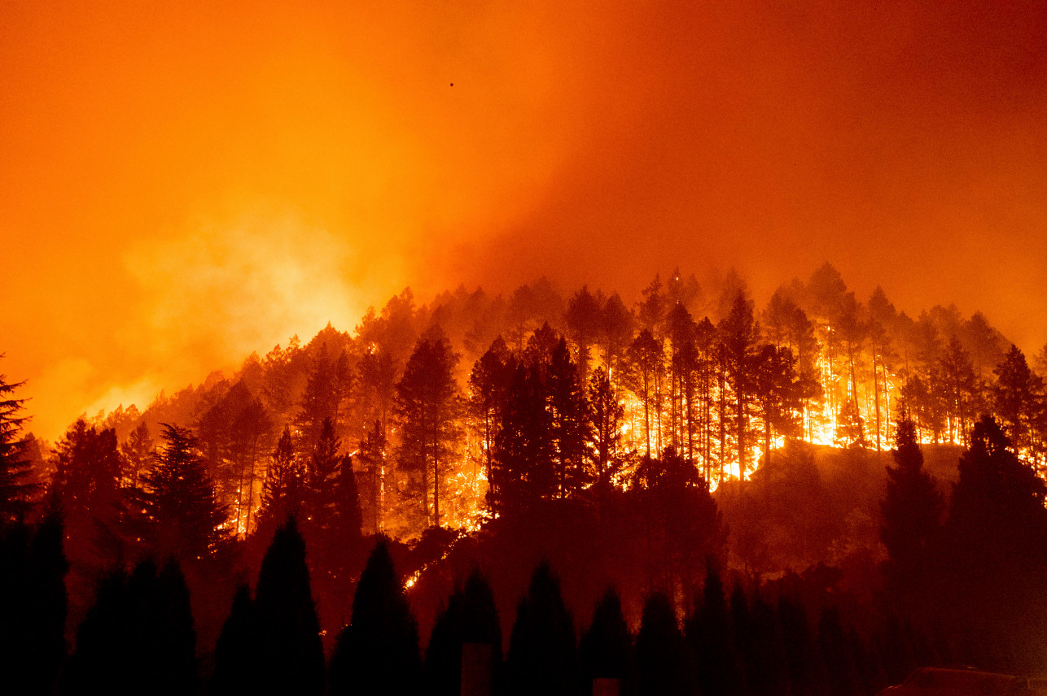
CALIFORNIA WILDFIRE CAUSE AND EFFECT ANALYSIS
JASON LEI
JOSH GALLAGHER
THADDEUS GRAY
WAN XIA (SUSAN)
YU-HAN CHEN (AMY)

Slide 2
Project Motivation
Motivation - With wildfires becoming an increasing problem in California, we wanted to see if we could find an trends in the causes and effects of the fires
Cause of wildfires - Weather factors - Human activities
Effects of wildfires
- Air quality - Financial cost

Slide 3
Causes of Wildfires: Weather
Questions
Is there a difference between average weather on any day for a location, and the weather in the location of a fire?
Are there weather trends in the time prior to the fire being contained?

Slide 4
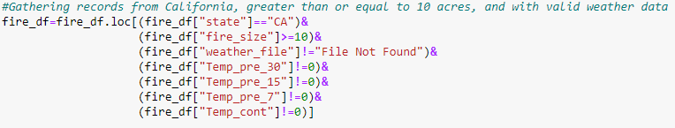
Weather Data Cleaning
Limited to California
Removed fires less than 10 Acres
Removed records that did not have weather files
Removed records where temperature equaled exactly 0

Slide 5
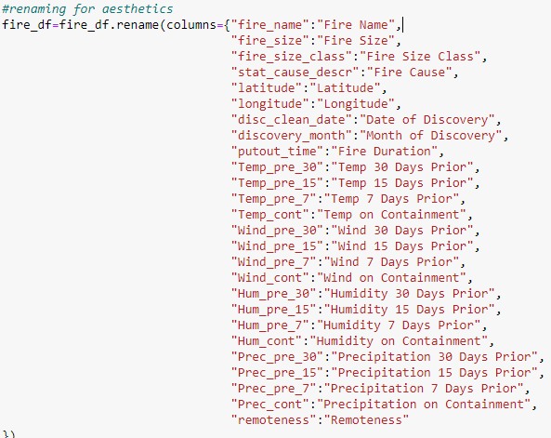
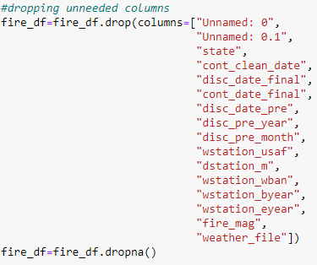
Weather Data Cleaning
Removed columns that would not be used
Renamed columns so Dataframe would be more aesthetically pleasing

Slide 6
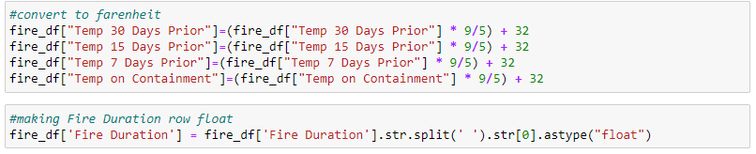
Weather Data Cleaning
Converted to Fahrenheit
Fire Duration column needed strings removed and to be turned into float for later calculations

Slide 7
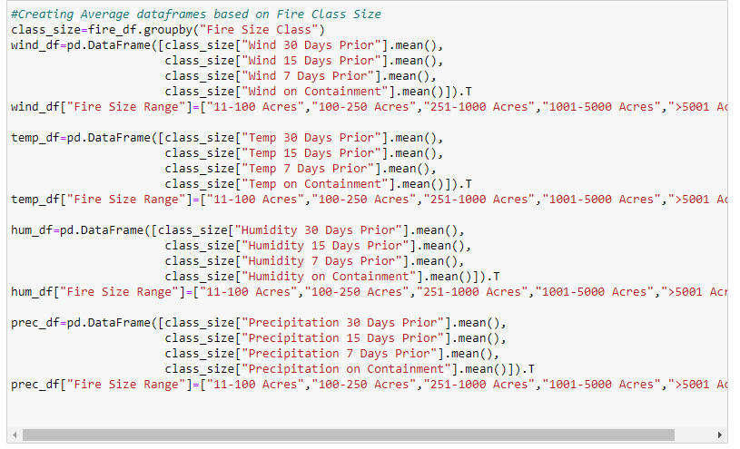
Weather Data Cleaning
Grouped data by the size of the fire
Created separate dataframes for wind, temperature, humidity, and precipitation
Took averages for time periods prior to fires’ containment

Slide 8
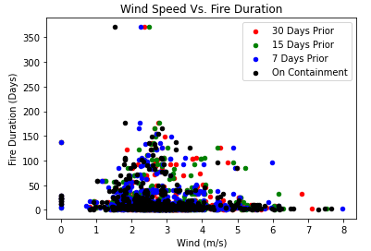
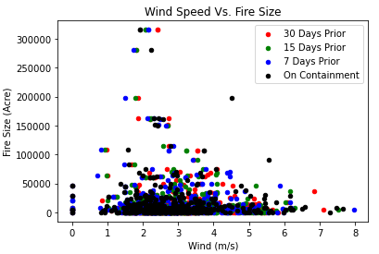
Wind
Mostly grouped in 1 to 5 m/s
Duration drops significantly above 5 m/s
Lots of datapoints at 0 m/s, however none in between until almost 1 m/s. Could be error in measurements or data.

Slide 9
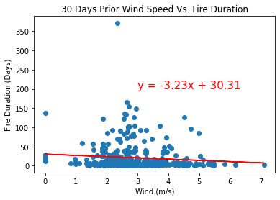
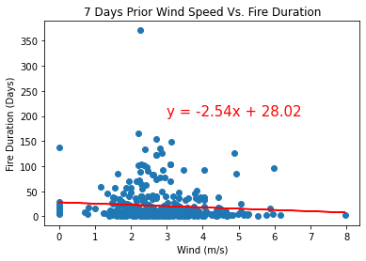
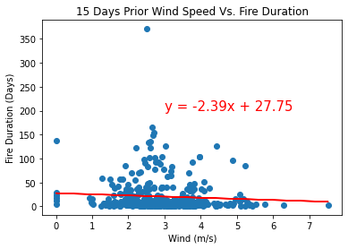
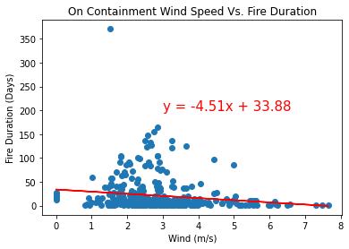
Wind

Slide 10
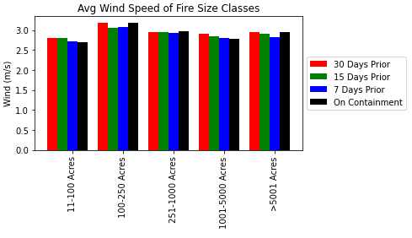
Wind
There appears to be a consistent pattern of wind speed averages dropping until date of containment

Slide 11
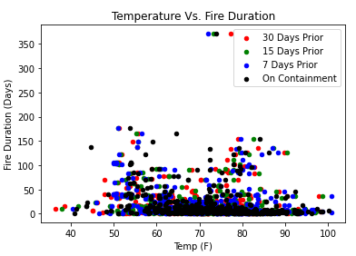
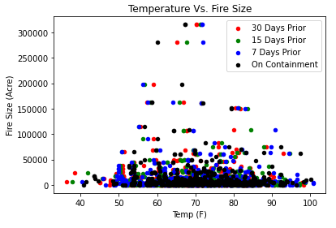
Temperature
Not much can be inferred from these graphs

Slide 12
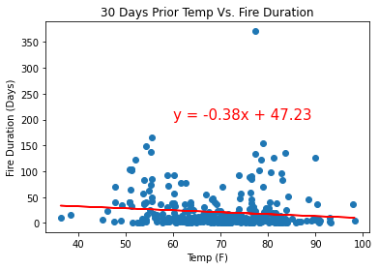
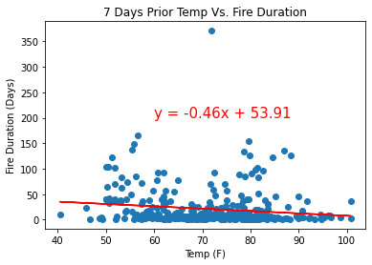
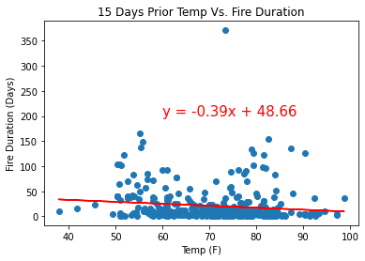
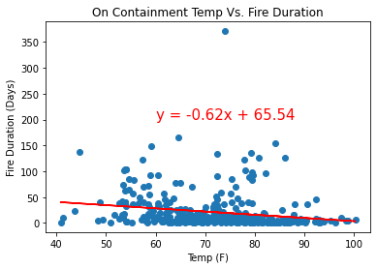
Temperature

Slide 13
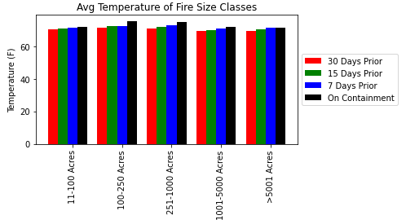
Temperature
The temperature rises up until date of containment
Temperature averages are consistent across all fire sizes

Slide 14
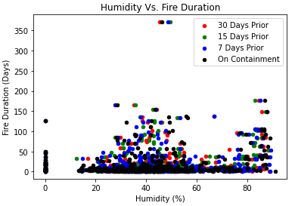
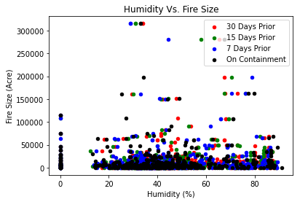
Humidity
Between 60 and 75% humidity, there is a decrease in the duration of the fires
Data clumped at 0% humidity, but none until about 10%

Slide 15
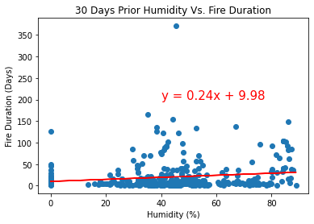
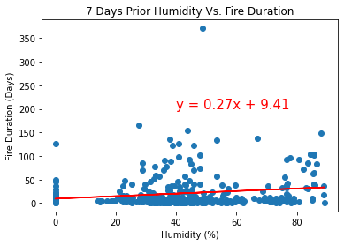
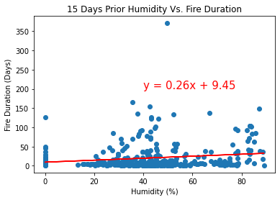
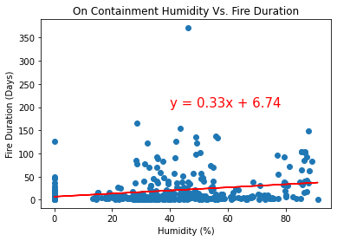
Humidity

Slide 16
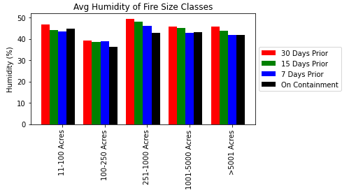
Humidity
Humidity decreases up until the date of containment
Fires 100-250 acres tend to have lower humidity

Slide 17
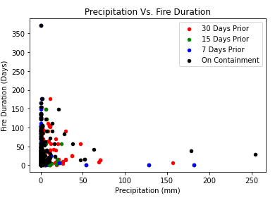
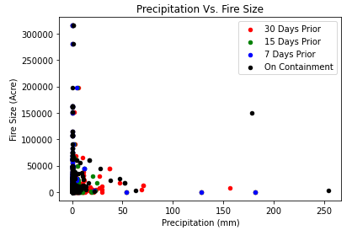
Precipitation
Data for both graphs is clumped at 0 precipitation
Fires greater than 75,000 acres have little to no precipitation

Slide 18
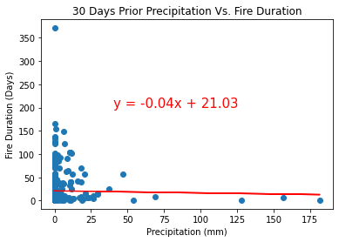
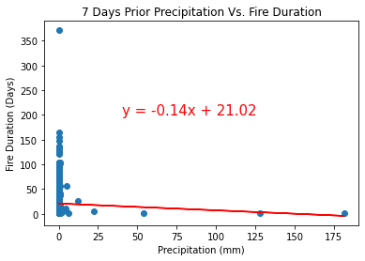
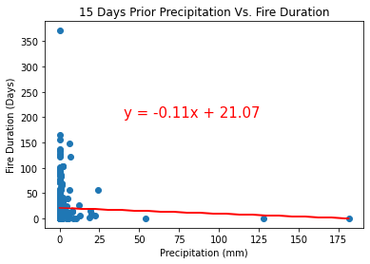
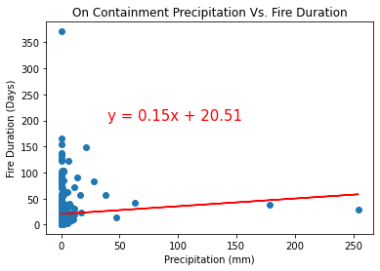
Precipitation

Slide 19
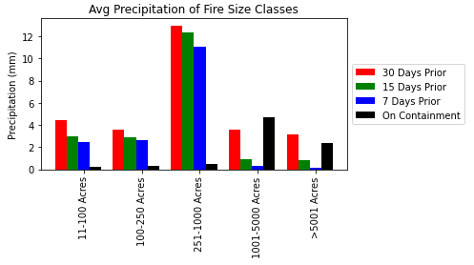
Precipitation
Precipitation averages are surprisingly high 30 days prior
Large fires have spike of precipitation on containment. Rainfall may have helped containment
Fires between 251 and 100 acres have much higher precipitation levels than other size groups
Could be related to storm systems with lighting causing mid-range fires
Precipitation for fires 11-250 acres is suspiciously low. Could be data error.

Slide 20
California Wildfire Costs Analysis
What regions in California have the highest costs of wildfire damage?
What are the human causes that cause the most damage?

Slide 21
Background
I have chosen datasets from four different years: 2019, 2018, 2017, 2016
Each data set presents the costs of human causes per Cal Fire Region
Basically, some counties are grouped in these regions, as a single Cal Fire unit can cover the entire area

Slide 22
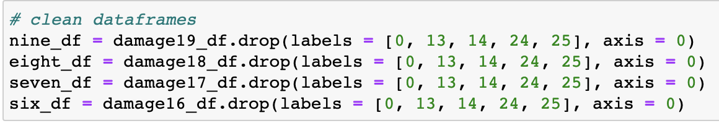
General Data Cleaning
Removed extraneous rows such as ”Northern Region” and ”Southern Region” as I analyzed the data with no distinction, and those rows had no data.

Slide 23
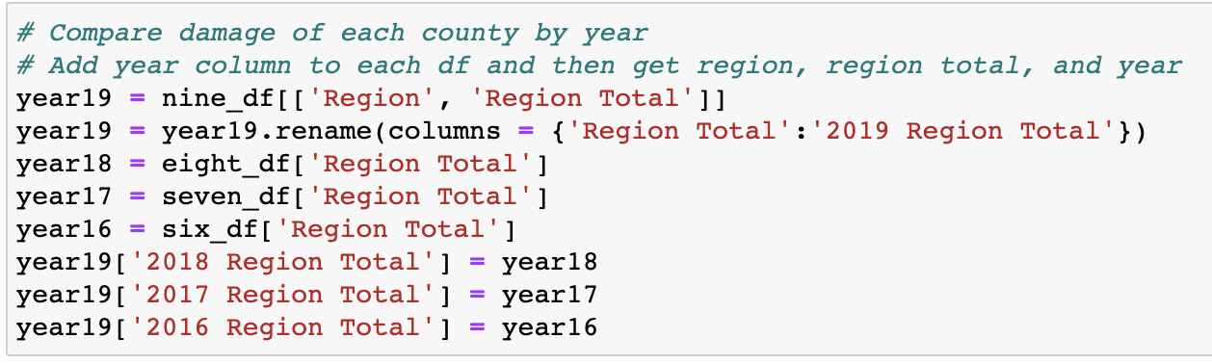
Combining Data for First Plot
I felt it would be easier to plot all four graphs at once if I combined data into one dataframe
Specifically chose region totals for this plot

Slide 24
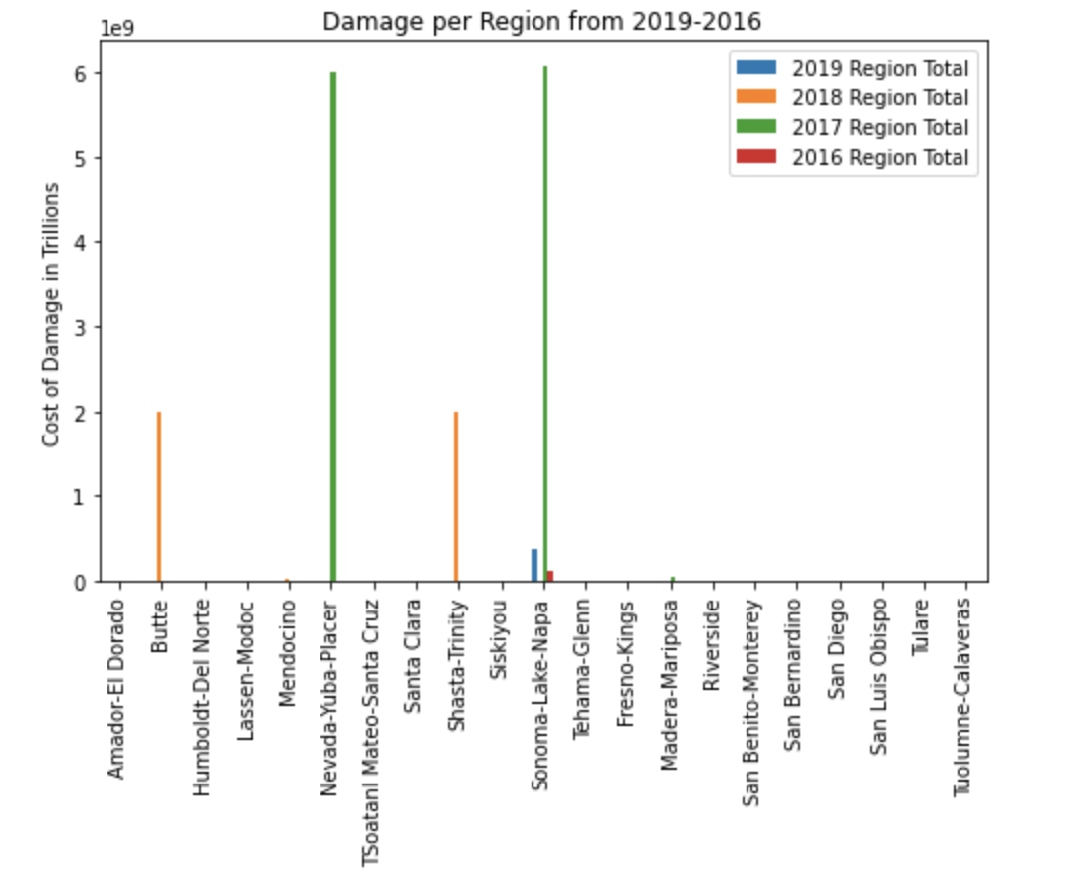
Damage per Region 2019-2016
Represents total cost of wildfire damages pre region (in Billions)
There are several regions with major outliers, which is why it looks like there is missing data
Sonoma-Lake-Napa has had massive damages in three of the past four years
This area clearly is a hotspot for wildfires, with Butte, Nevada-Yuba-Placer, and Shasta-Trinity being potentially dangerous spots

Slide 25
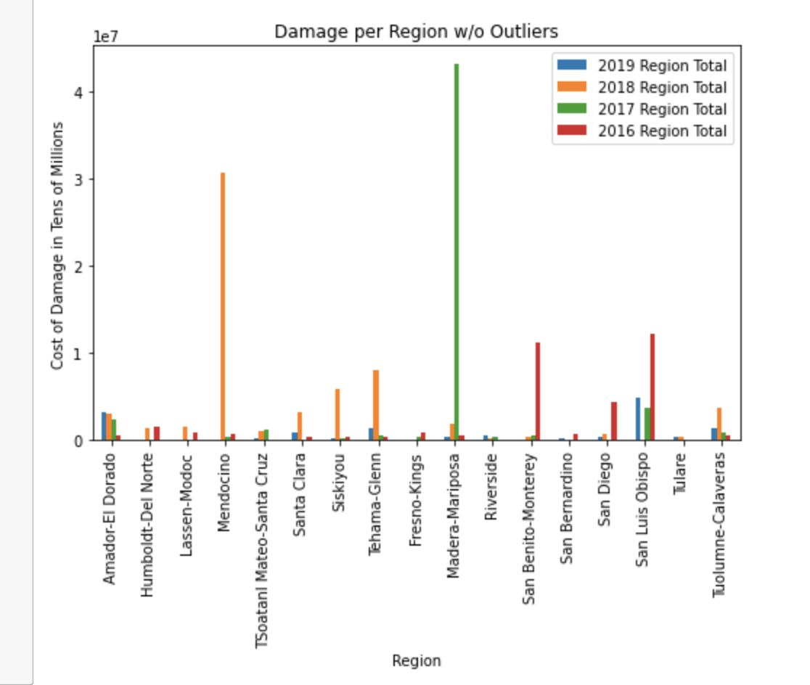
Damage per Region w/o Outliers
Dropped regions with the jumps in cost
Wanted to show how large the difference was between the outliers and “normal” fires

Slide 26
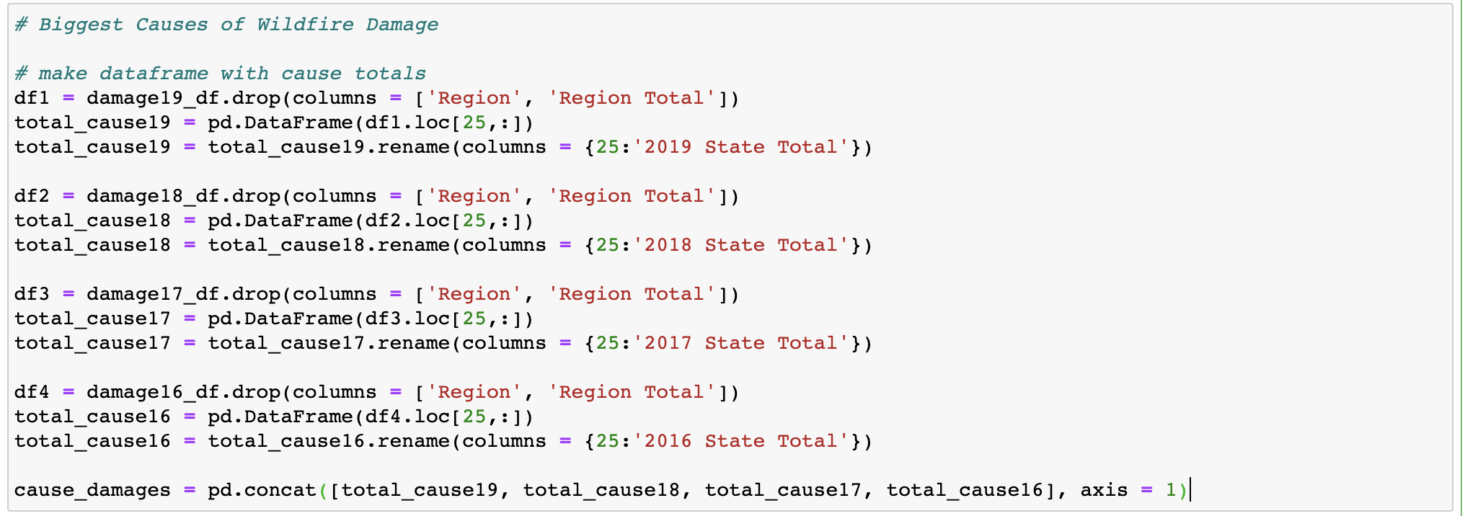
Create Dataframe for Costs per Cause
Create a Dataframe to pickout the costs of damages from human causes

Slide 27
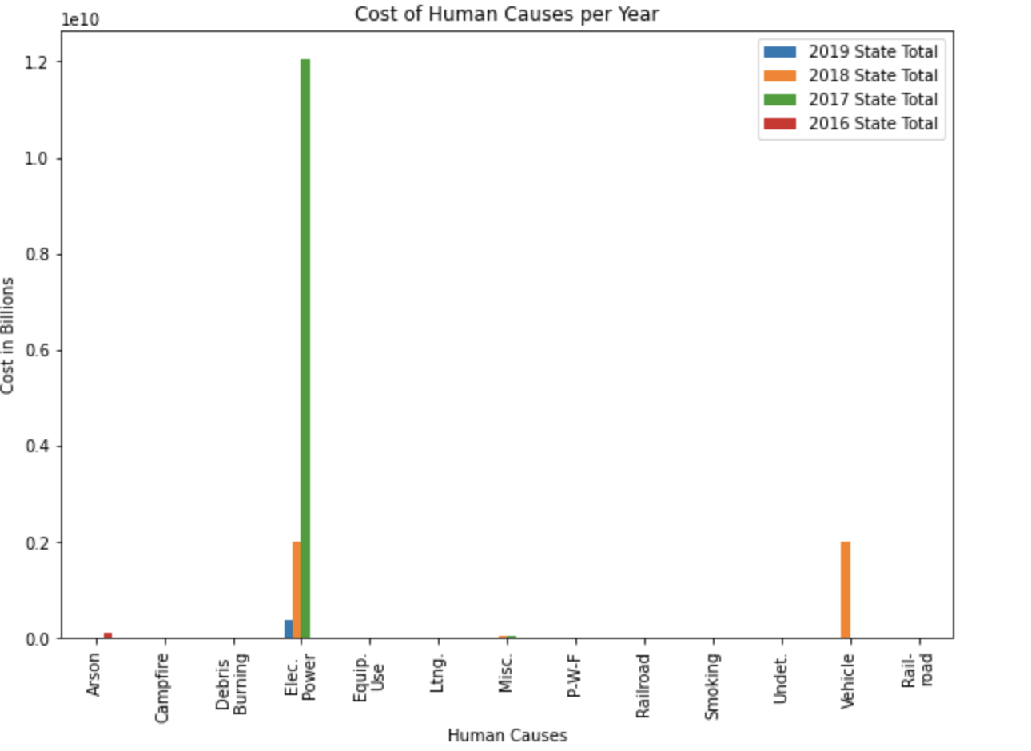
Costs for Human Causes per Year
Represents the costs of human causes per year
Similar to costs per region, there are clear outliers
Electric power seems to be the top cause of wildfires, with three out of four years seeing significant costs
The other costly causes would be from arson and vehicle fires

Slide 28
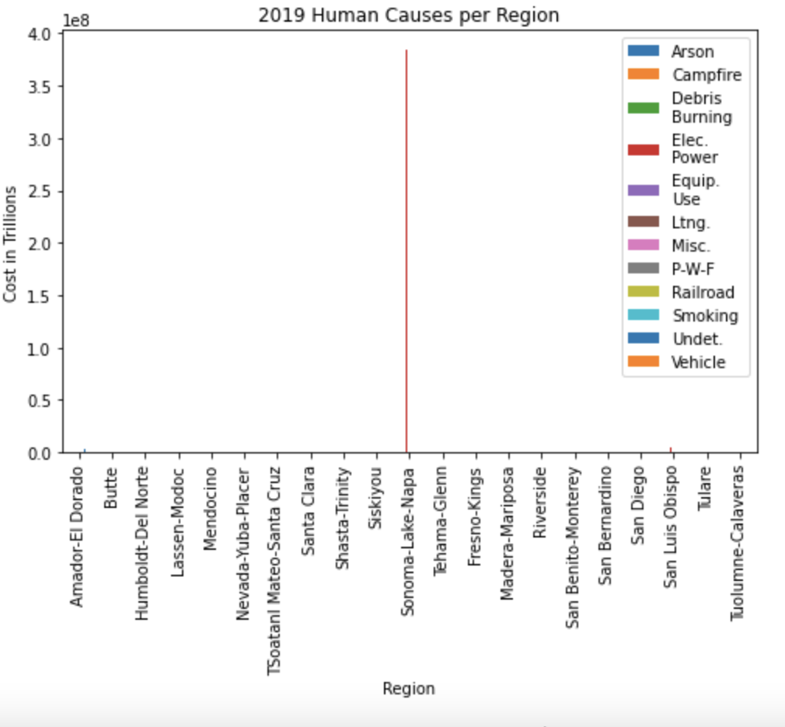
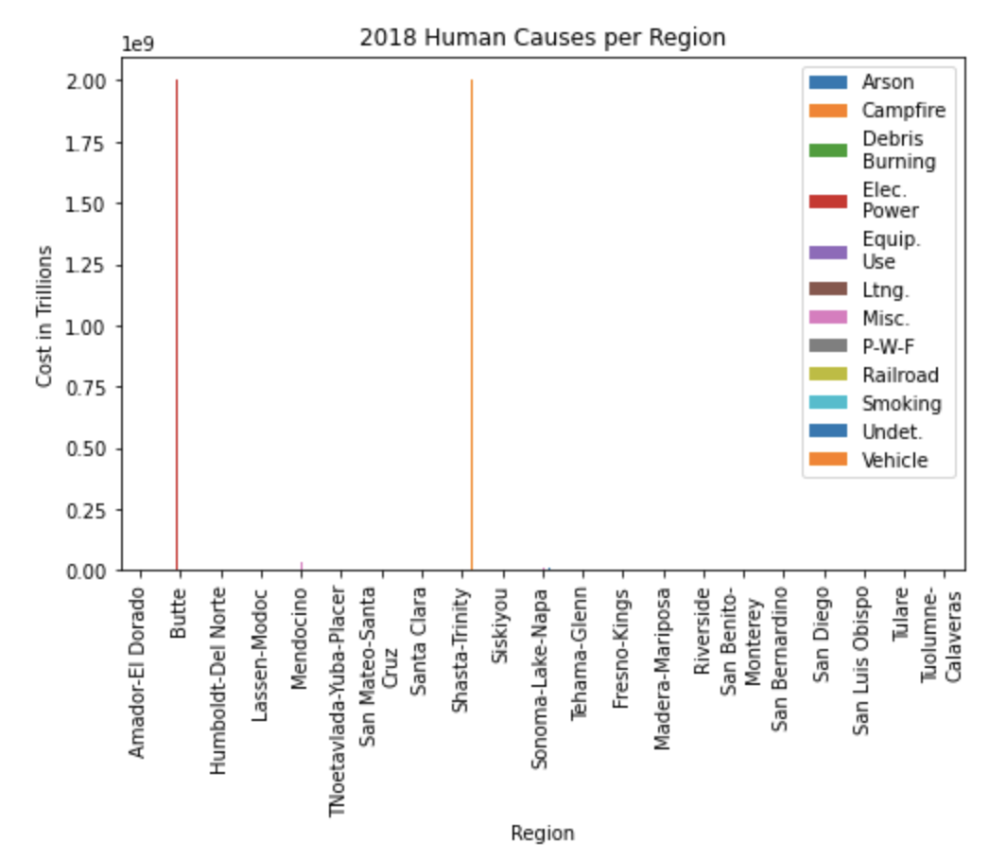
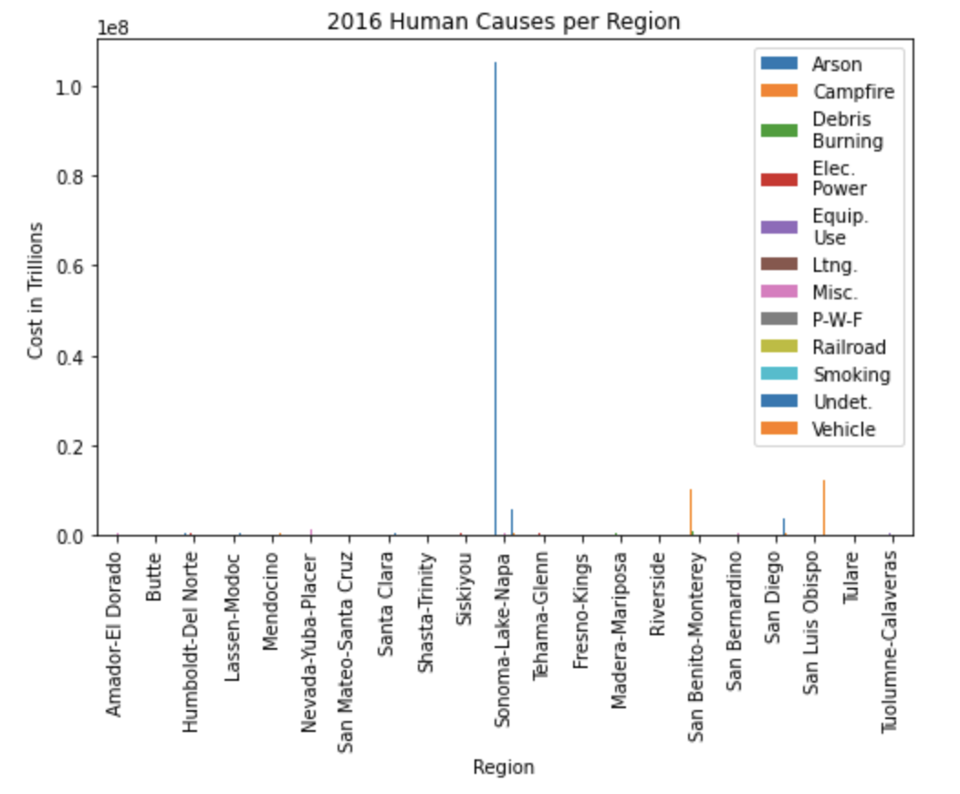
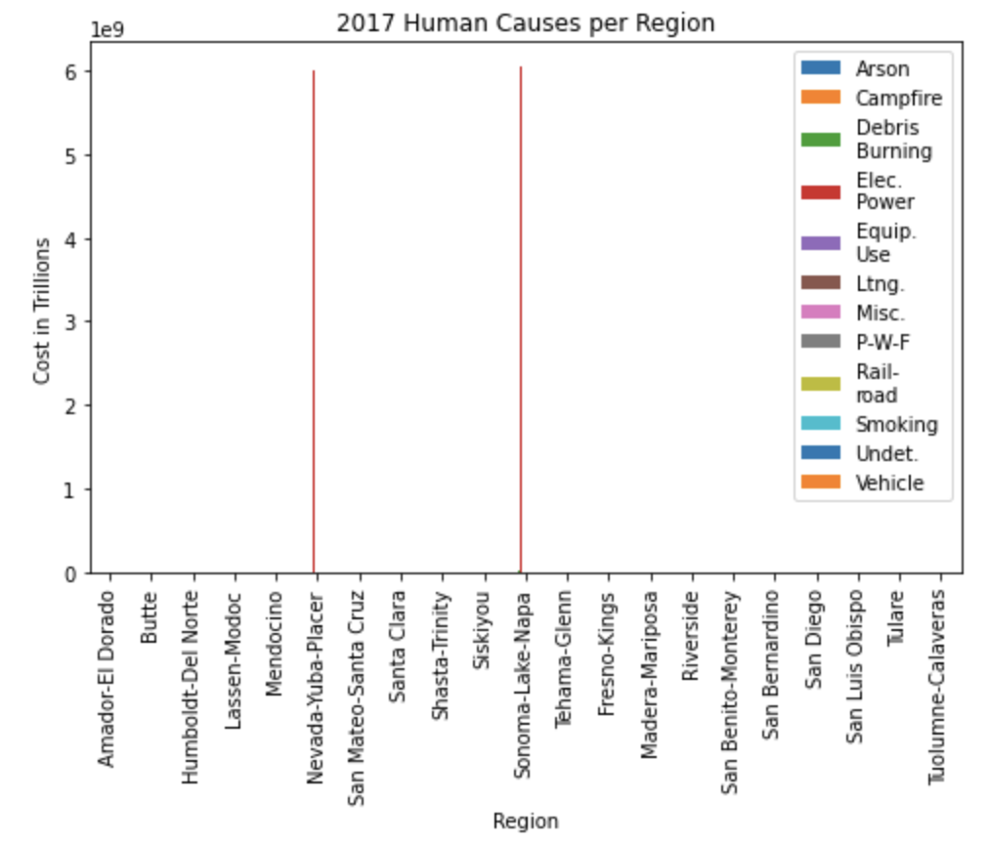
Costs of Human Causes per Region
Each graph represents a year
Bar plot represents major costs in human causes per region
As shown before, electric power is the primary cause for wildfires, along with arson and vehicles
Sonoma-Lake-Napa is once again the most prolific area for wildfires

Slide 29
Effect of Wildfires: Air Quality
Is there a difference in PM_{2.5} (air pollutant) concentration
before and after the Woosley fire?

Slide 30

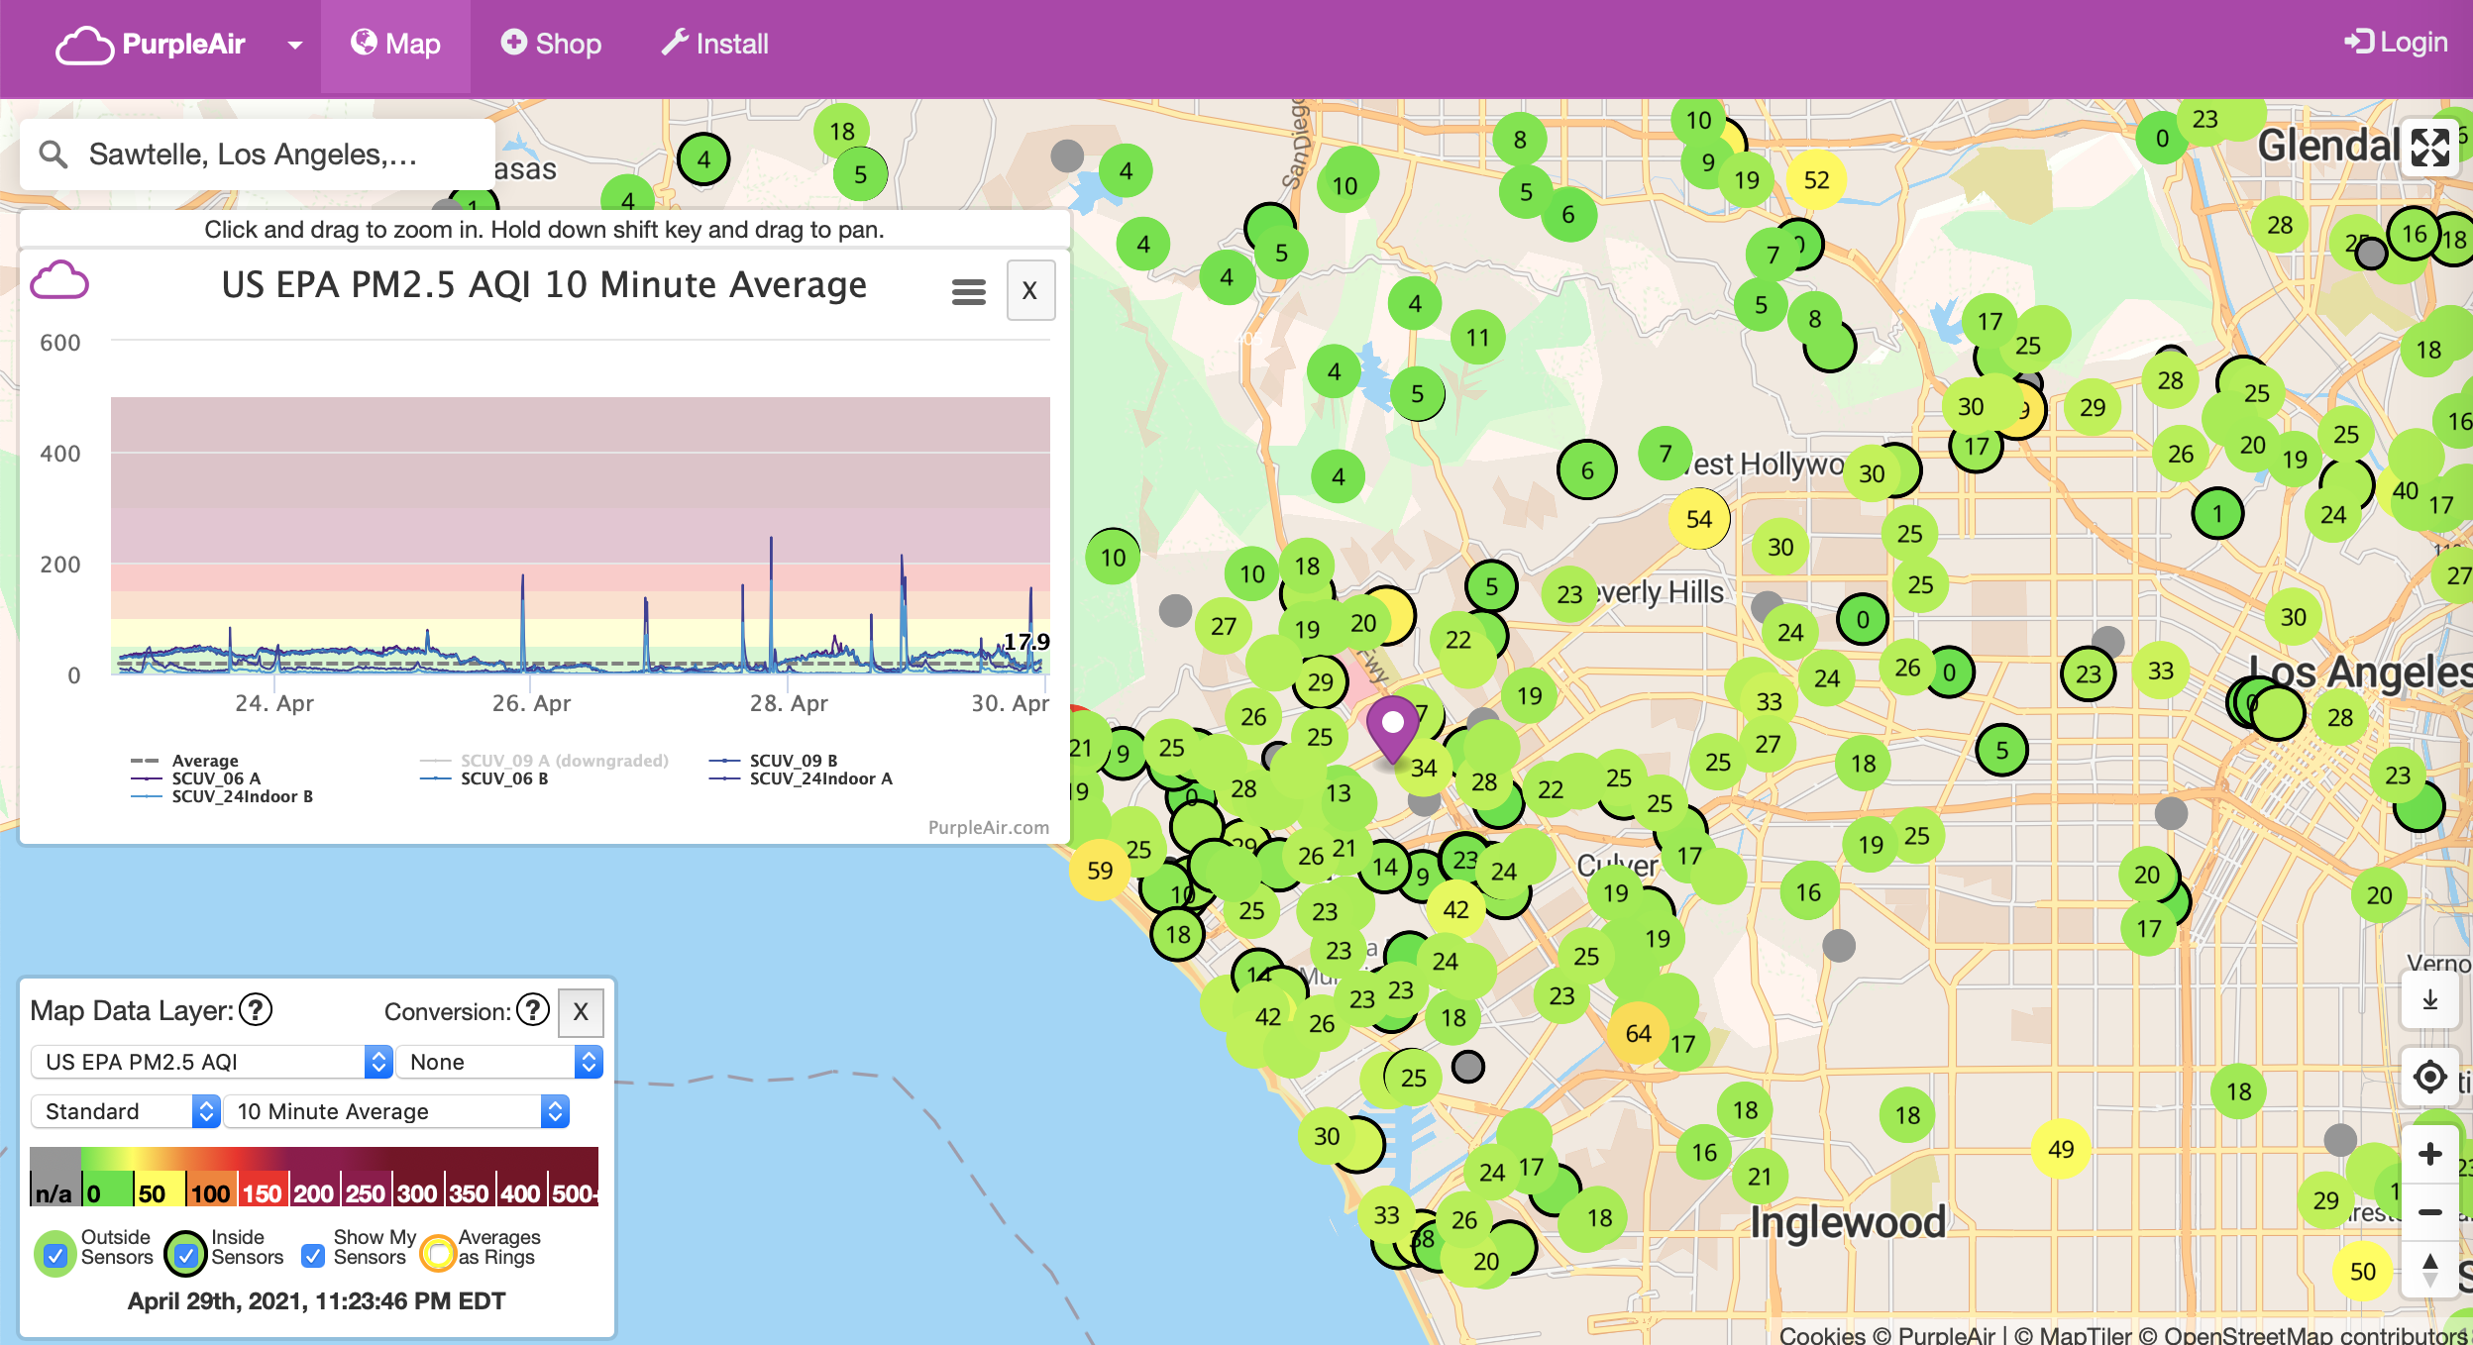
Low-cost air sensor

Slide 31
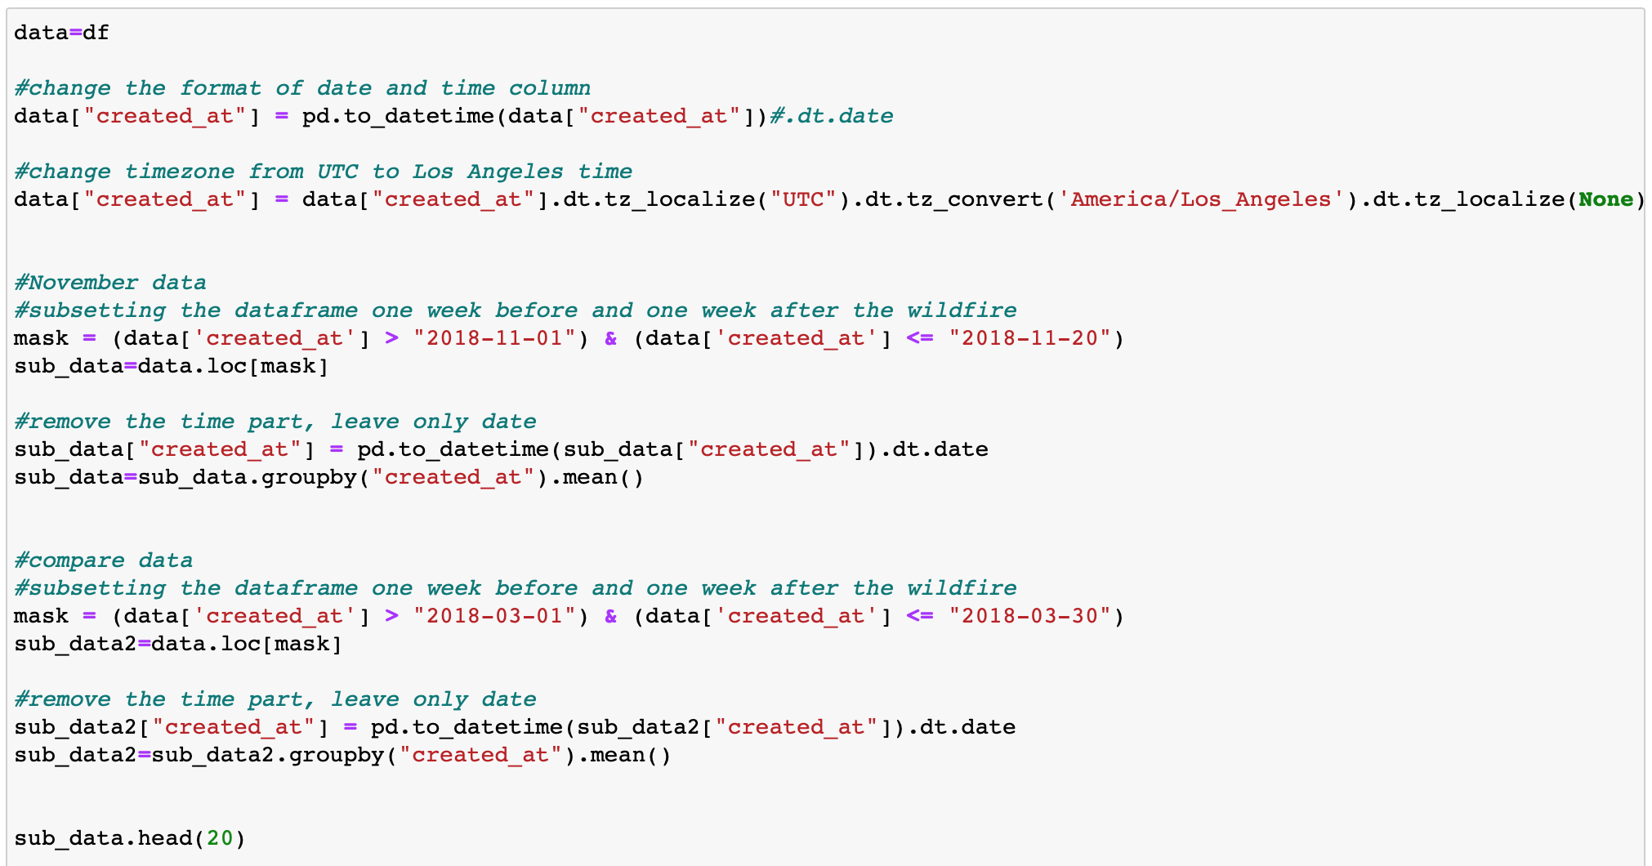
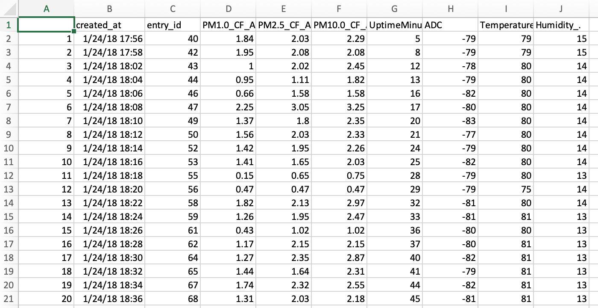
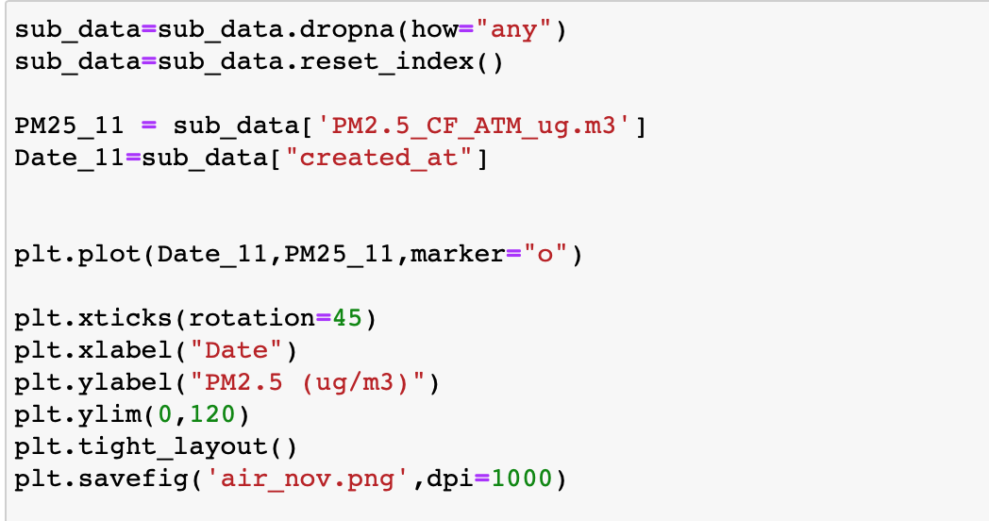
Data Cleaning and Processing

Slide 32
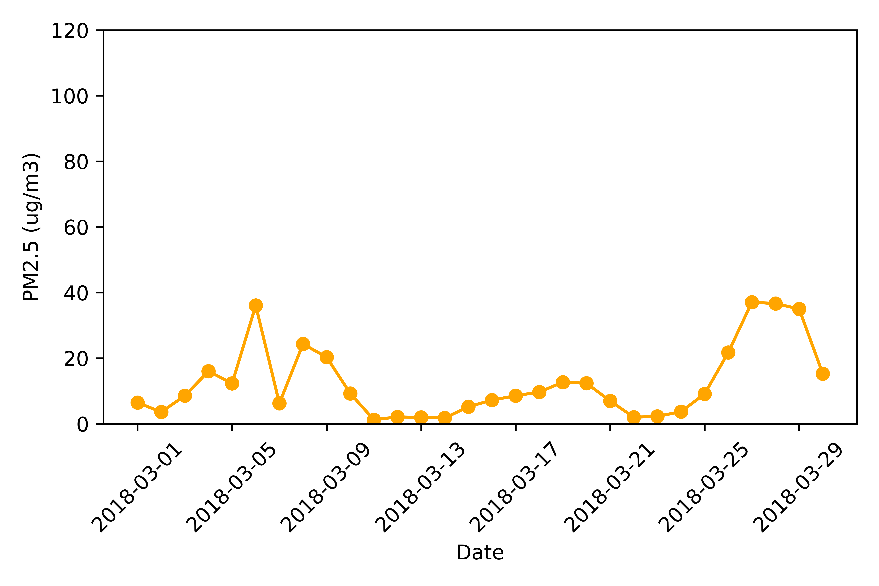
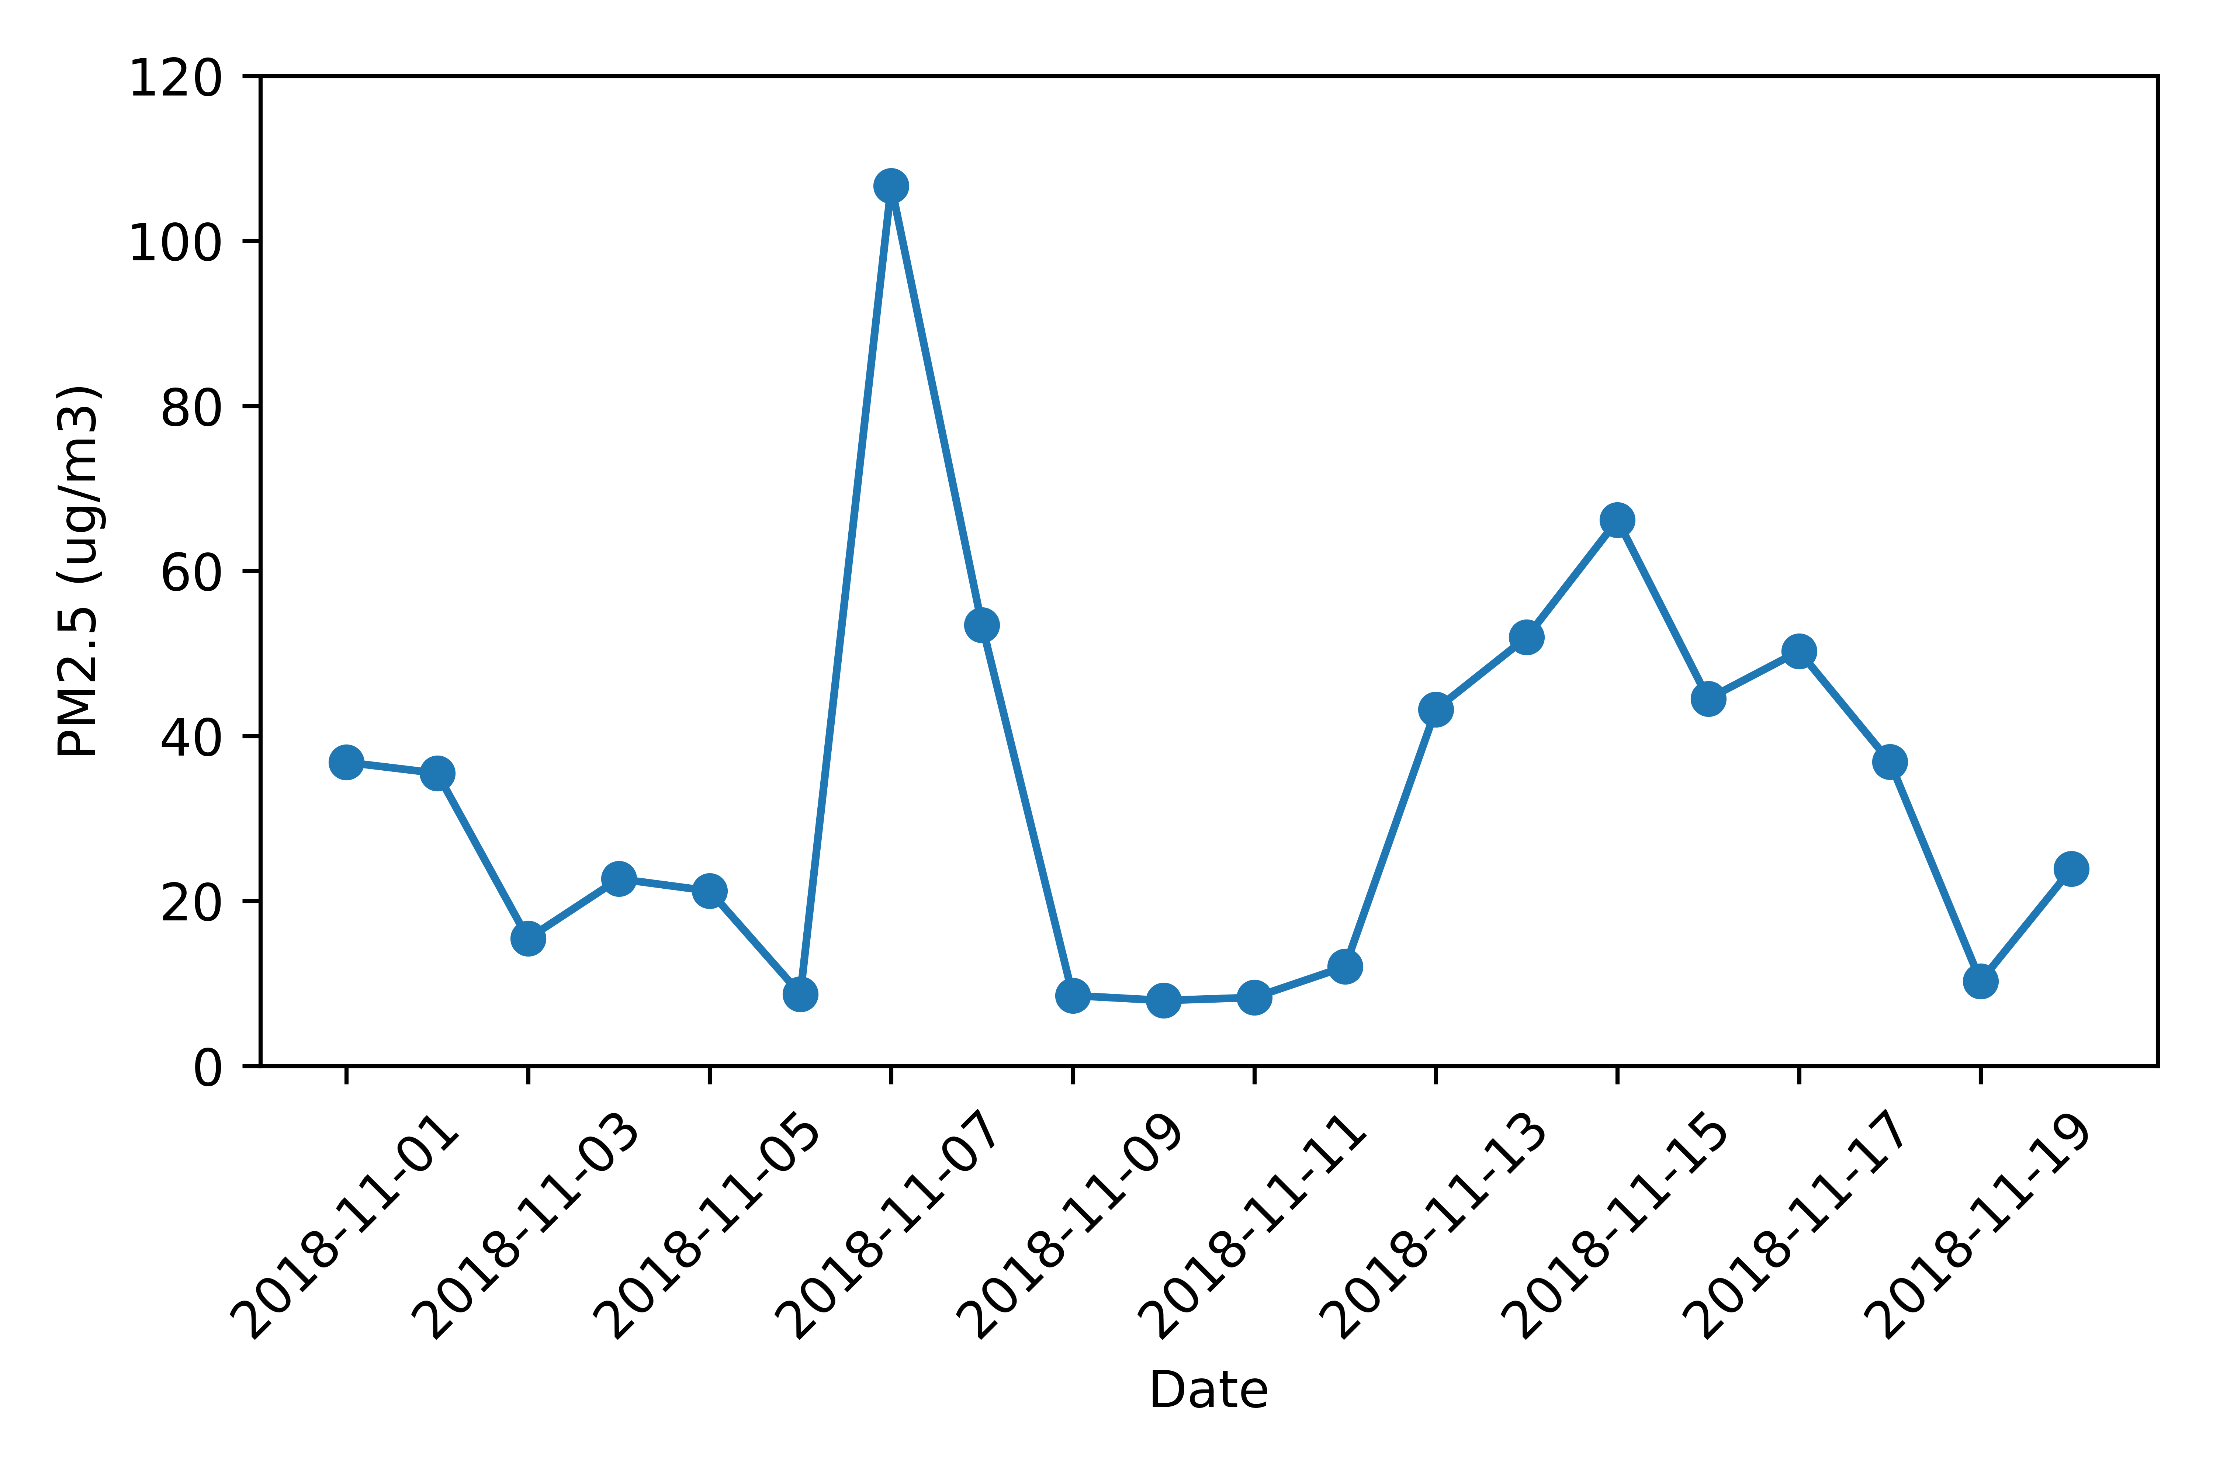
Non-wildfire season
wildfire season
Woosley Fire starts
EPA 24 hours standard: 35ug/m³

Slide 33
Wildfire Maps
Questions:
Where were the wildfires located in California?
Where were the large scale wildfires located in California?
(from year 1995 through year 2015)

Slide 34

Fire Location Map - using API
Los Angeles and San Diego had slightly more fires happened during 1995 to 2015 according to the symbol map.

Slide 35

Fire Size Heatmap - using API
The majority of large scale wildfires happened from 1995 to 2015 were close to Los Angeles and San Diego according to the fire size heatmap.

Slide 36
Conclusions
From our analysis, the weather factors (Wind speed/Humidity/Temperature/Precipitation) have correlations with the fire size up until the date of containment, but it is unclear whether the weather impacted the fires or vice-versa
There Is a strong correlation between electrical power and Sonoma-Lake-Napa having the highest wildfire costs. Additionally, electrical power in all areas seems to have a strong correlation with wildfires
Wildfire increases air polution in surrounding areas

Slide 37
Limitations and Discussions
We are not able to merge our datasets: data are from different years
Real world data cleaning: missing information or wrong information
More to explore:
- Impacts from wildfires on water resources: water quality within and downstream from a burn area may be significantly impacted.

Slide 38



